Slide 1
Host – superhost an analysis on Airbnb Data
MSIS 642 Multivariate and Regression-FALL 2022
Shreya Chanda

Slide 2
TABLE OF CONTENTS
INTRODUCTION
MOTIVATION
LITERATURE REVIEW
THEORY AND HYPOTHSES
DATA SOURCE
ABOUT DATA
VISUALIZATION
CORRELATION
RESULTS
CONCLUSION
REFERENCES

Slide 3
INTRODUCTION
Barcelona welcomes more than 27 million visitors each year.
With a daily charge of $167 and monthly earnings of $2691 for Barcelona's short-term Airbnb properties, the average occupancy rate is 78%.
The listings are created when hosts put their properties on the Airbnb system and are available for guests to stay. Listings include all the information that describes the properties like price, description, and location.

Slide 4
MOTIVATION
The main objective of this case study is to help the new customers using Airbnb to create transparency for the factors determining a host to become a super host.
The classic goal is to improve the areas that can help a host become a super host by using a model to analyze different attributes and find their importance level to narrow down the focus on them.
This project consists of data provided by Inside Airbnb with detailed, review and calendar data of September 2022.

Slide 5
LITERATURE REVIEW
“Superhost” badge to hosts who receive good reviews and observes how this can impact an accommodation's review volume and ratings.
Will a superhost have more visibility, earning potential, and exclusive rewards for their outstanding hospitality?.
The https://mohamedirfansh.github.io/Airbnb-Data-Science-Project/. Done by Mohamed helps us understand that customers looking for Airbnb host must focus on factors that maximize the price of listings and minimize the price listings for the customers with a right pricing by providing the needed amenities.

Slide 6
THEORY AND HYPOTHESES
Null Hypotheses : There is no effect of ratings or other variables on a host being a supershost.
Alternate Hypotheses: There is effect of ratings or other variables on a host being a supershost.

Slide 7
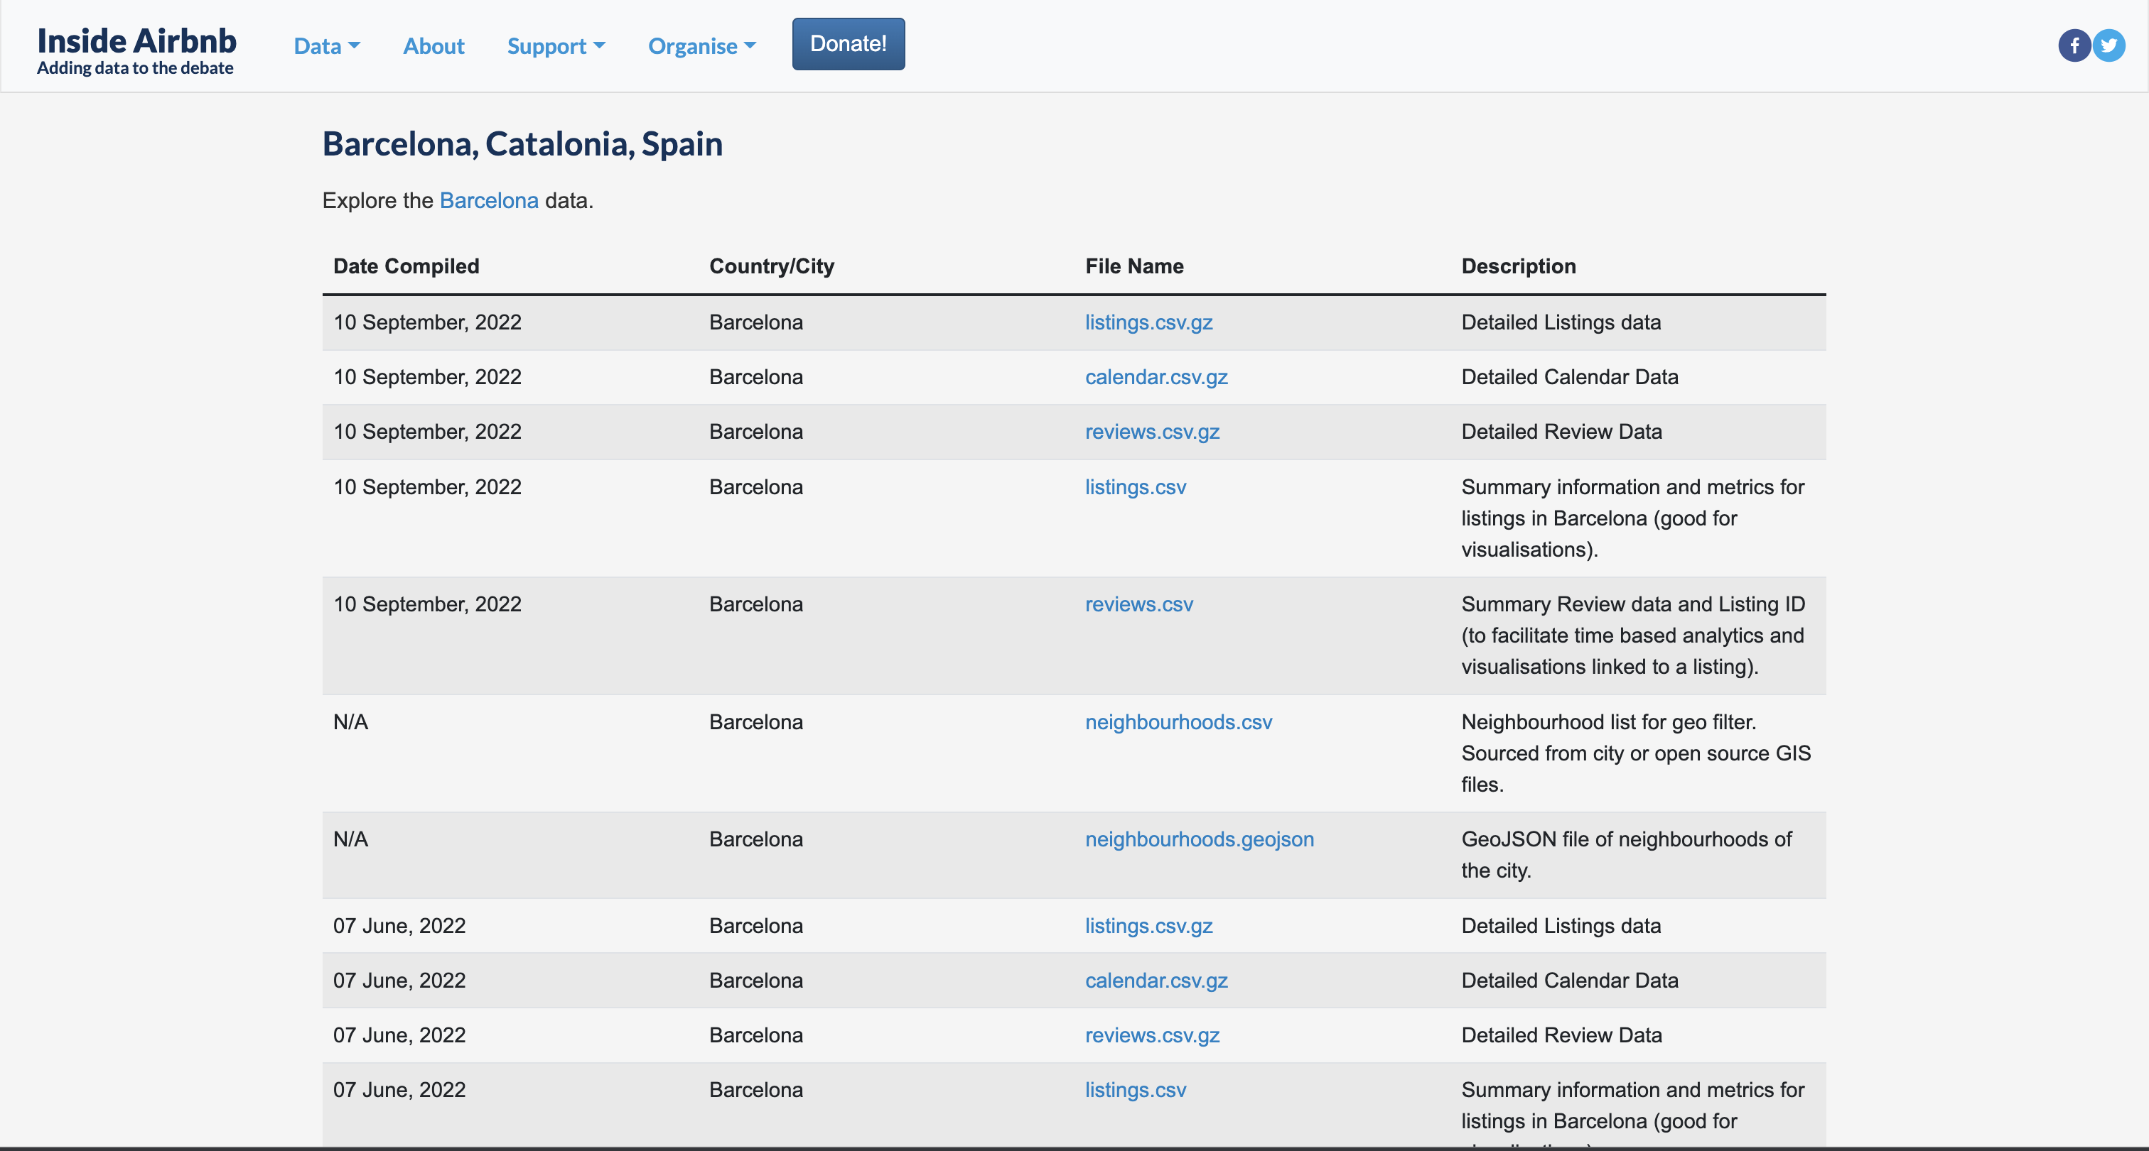
DATA SOURCE
http://insideairbnb.com/get-the-data/

Slide 8
ABOUT DATA
Listings - Detailed listings data about hosts, Airbnb houses and price. The attributes used in the analysis are id (listing ID), name (name of the listing), host_id (host ID), host_name (name of the host), room_type (listing space type), and price (price in dollars).
Reviews - Detailed reviews given by the guests. Key attributes include number_of_reviews (number of reviews), last_review (latest review), and reviews_per_month (number of reviews per month).
Location - Provides details about Airbnb location in Barcelona city. Four attributes including neighbourhood_group (main area), neighbourhood (area), longitude, and latitude .
Rating

Slide 9
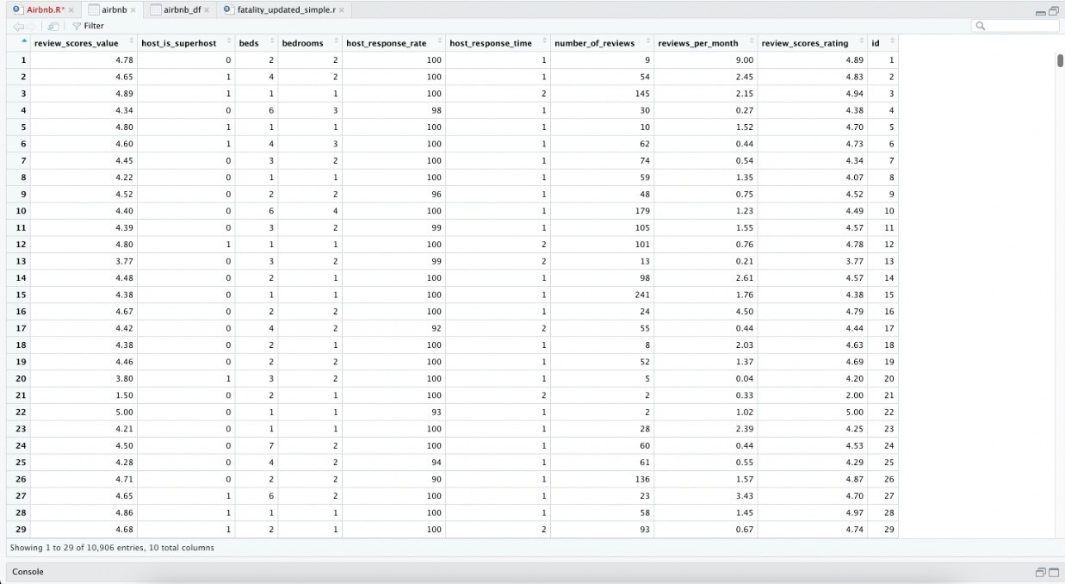
DATA SOURCE
Dependent Variable :- Host_is_superhost
Independent Variable :-
Review_scores_, beds, bathrooms, host_response_rate, host_response_time, number_of_reviews, reviews_per_month, and reviews_score_rating

Slide 10
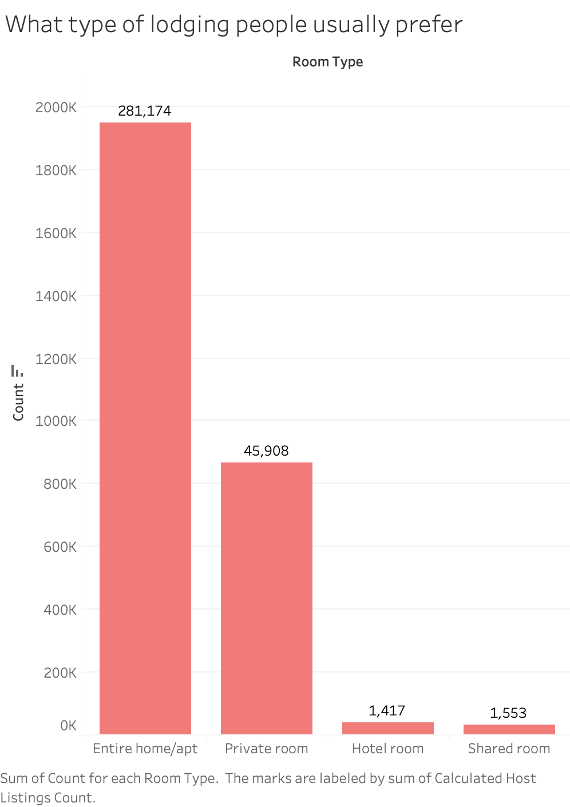
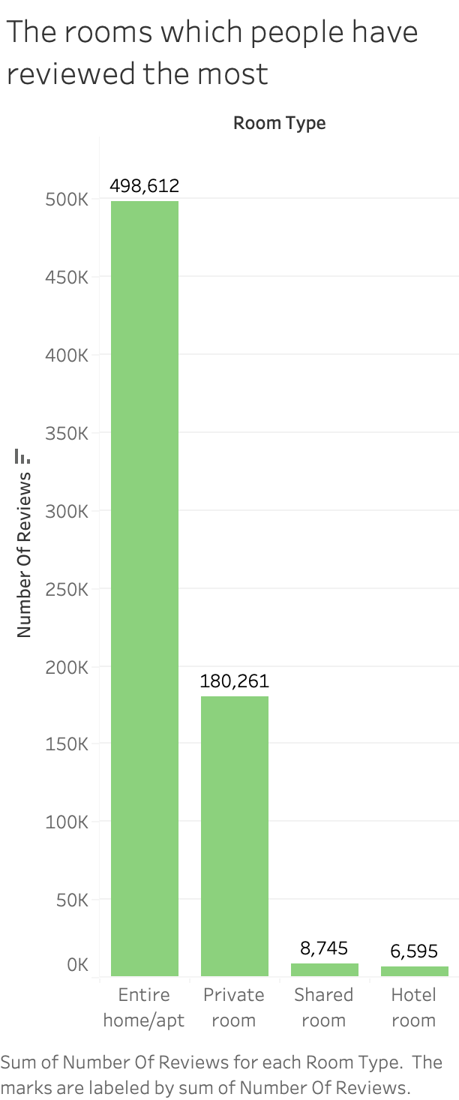
VISUALIZATION

Slide 11
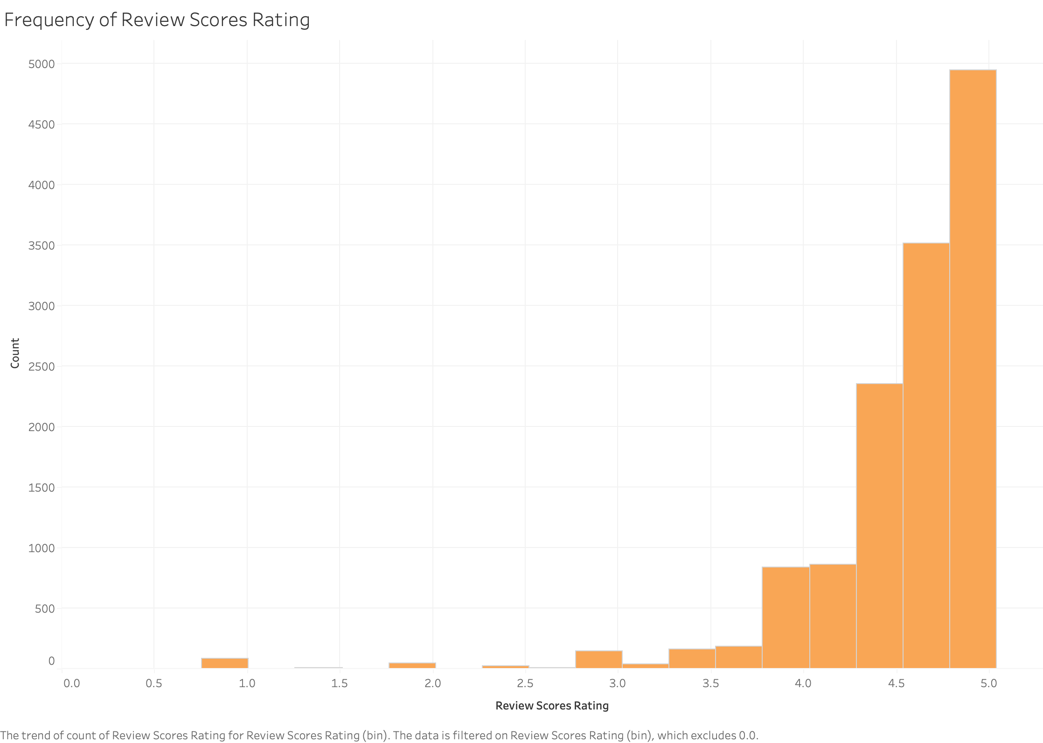
VISUALIZATION

Slide 12
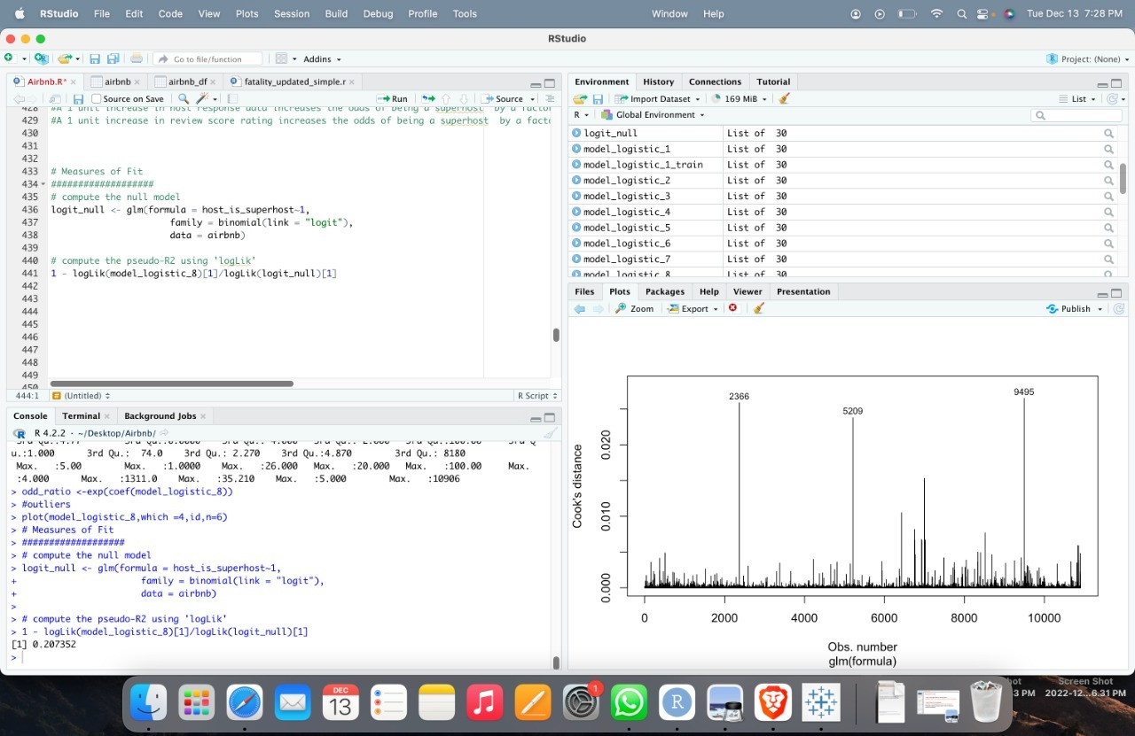
VISUALIZATION

Slide 13
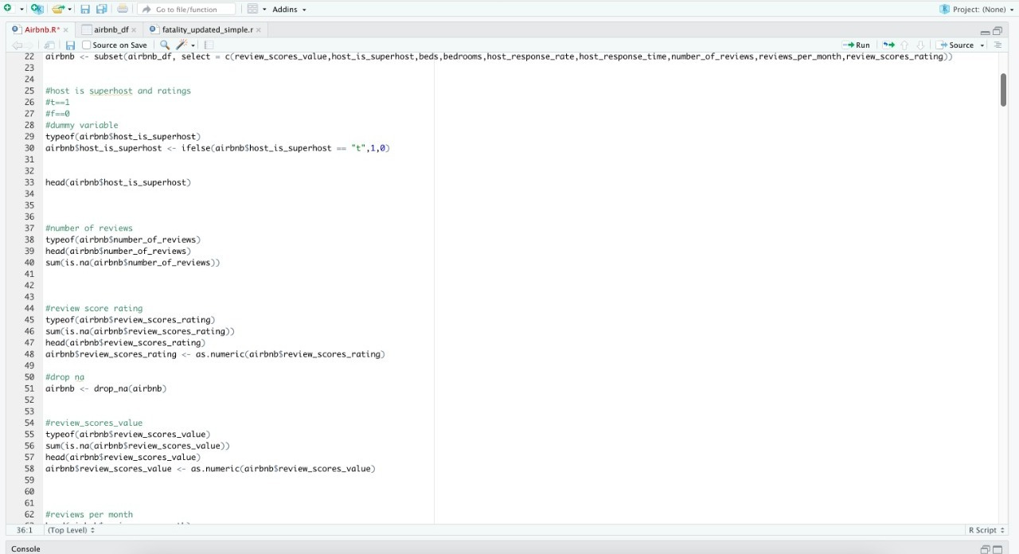
DATA CLEANING
Cleaning the data by checking for null values and removing attributes which are not required.

Slide 14
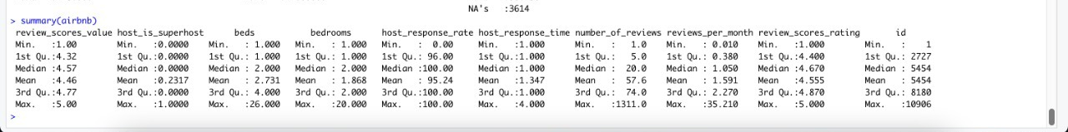
DATA SUMMARY

Slide 15
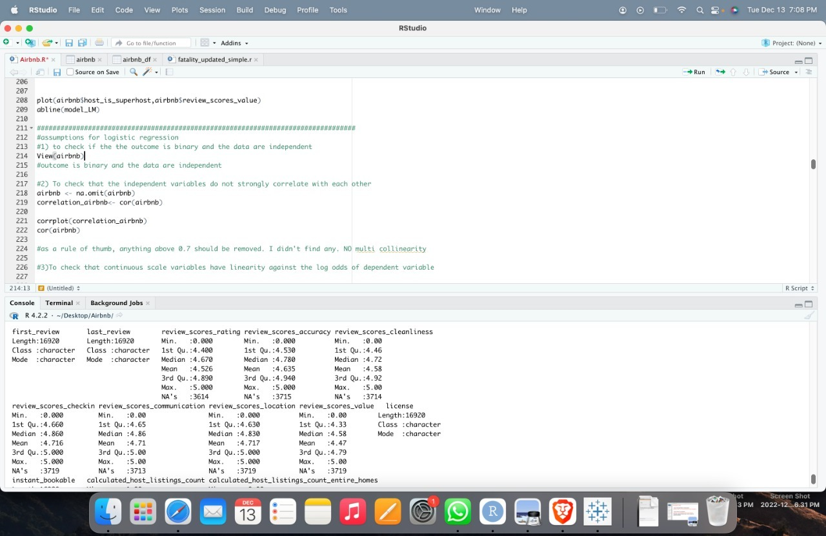
Checking Assumption for Logistic Regression
To check if the outcome is binary and is the data independent ?

Slide 16
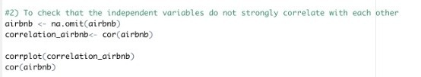
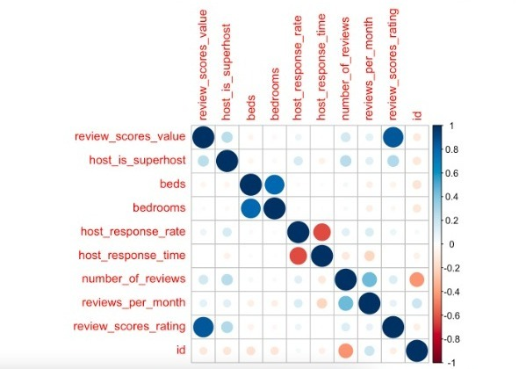
1. Corr(host_is_superhost, review_scores_value) = 0.245 2. Corr(host_is_superhost, beds) = -0.056 3. Corr(host_is_superhost, bathrooms) = -0.388 4. Corr(host_is_superhost, host_response_rate) = 0.157 5. Corr(host_is_superhost, host_response_time) = -0.070 6. Corr(host_is_superhost, number_of_reviews) = 0.254 7. Corr(host_is_superhost, reviews_per_month) = -0.118 8. Corr(host_is_superhost, reviews_scores_rating = 0.271 9. Corr(host_is_superhost, id) = -0.0128
CORRELATION

Slide 17
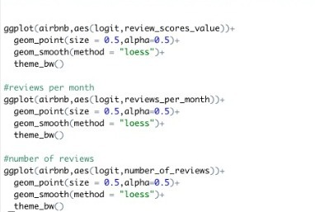
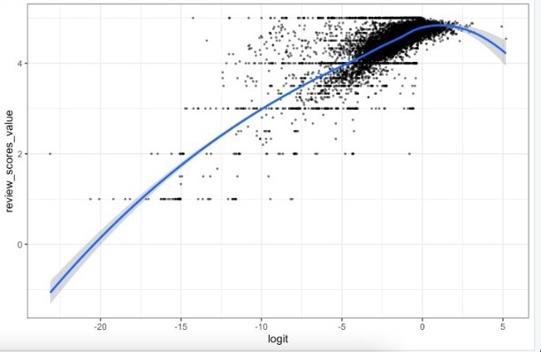
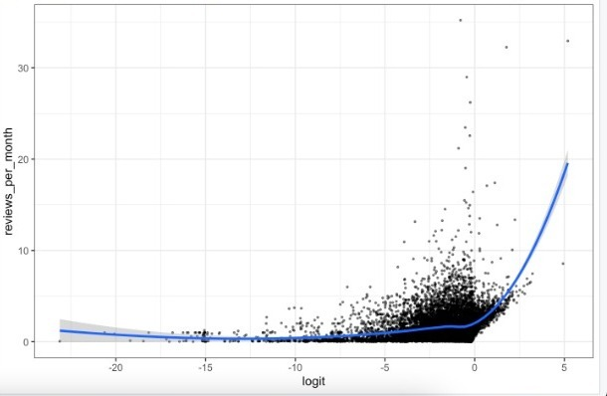
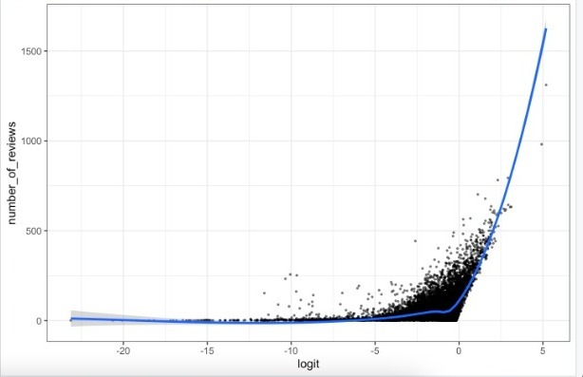
To check that continuous scale variables have linearity against the log odds of dependent variable

Slide 18
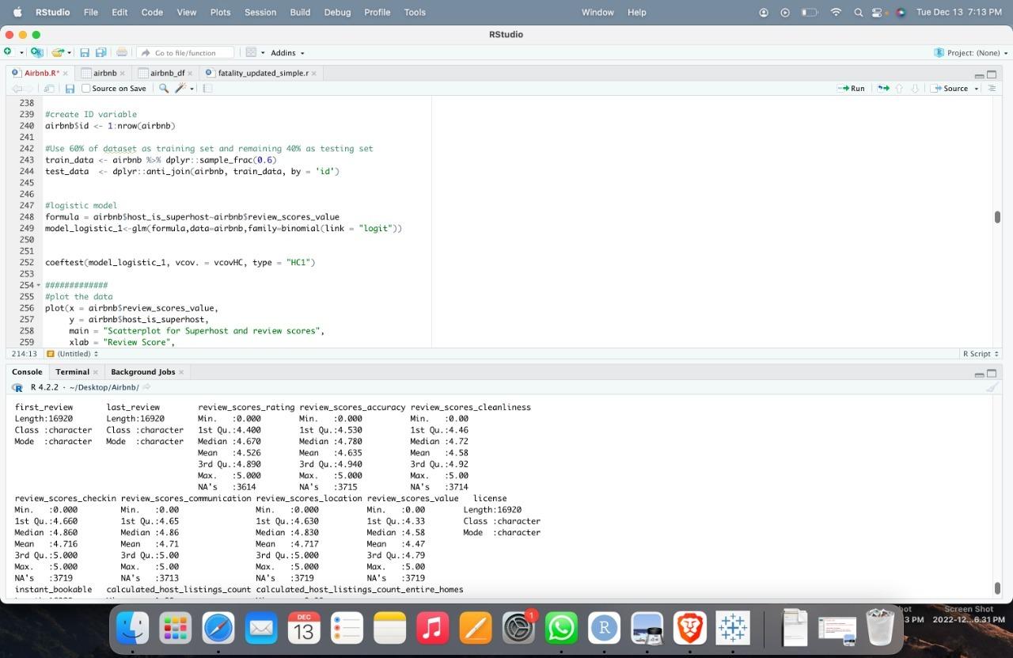
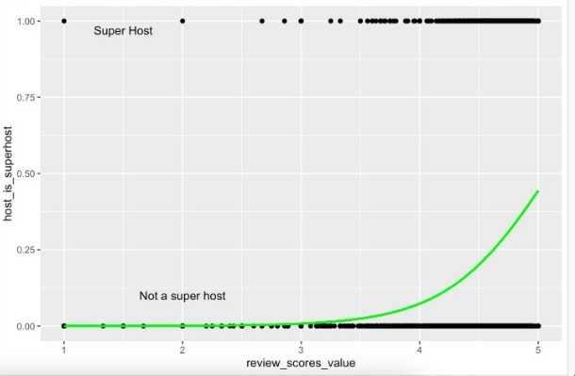
1ST LOGISTIC REGRESSION MODEL

Slide 19
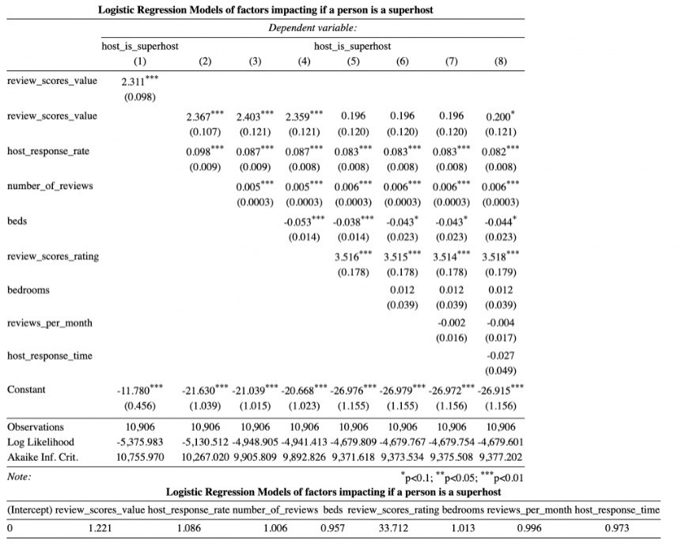
Results

Slide 20
RESULTS
One unit increase in the reviews scores rating increases the odds of host being a superhost by a factor of 33.71 holding the other predicted variables constant at a certain value.
Review_scores_, beds, bathrooms, host_response_rate, host_response_time, number_of_reviews and reviews_per_month have an odds ratios of 1 which indicates there is no change.
We reject the null hypotheses in favor of the Alternate Hypotheses.

Slide 21
CONCLUSION
This dataset tracks the Airbnb listings in the Barcelona over time by combining all the reviews, neighbhourhood, avalibility, amenities and ratings
Considering attributes like reviews, ratings and response testing ratio we focused on how the host is performing.
Our analysis indicates that Host has the highest correlation to review_score_rating.

Slide 22
REFERENCES
Xie, K. and Mao, Z. (2017), "The impacts of quality and quantity attributes of Airbnb hosts on listing performance", International Journal of Contemporary Hospitality Management, Vol. 29 No. 9, pp. 2240-2260. https://doi.org/10.1108/IJCHM-07-2016-0345
https://www.emerald.com/insight/content/doi/10.1108/IJCHM-07-2016-0345/full/html
Guttentag, D. (2019), "Progress on Airbnb: a literature review", Journal of Hospitality and Tourism Technology, Vol. 10 No. 4, pp. 814-844. https://doi.org/10.1108/JHTT-08-2018-0075 Zervas, G. Proserpio, D. and Byers, J. (2015), “A first look at online reputation on airbnb, where every stay is above average”, available at: https://ssrn.com/abstract=2554500 (accessed 19 January 2018).

Slide 23
THANK YOU
Does anyone have any questions?

